Slide 1
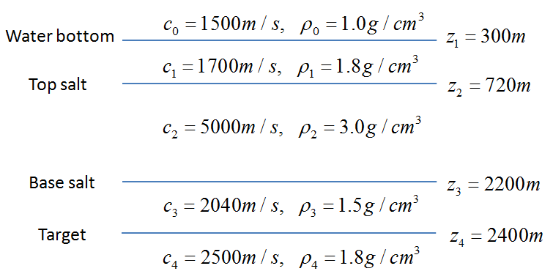
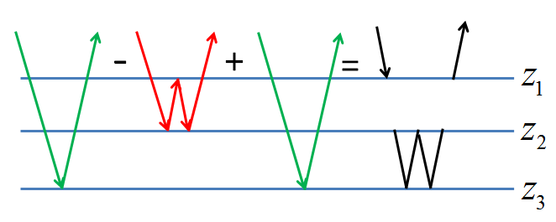
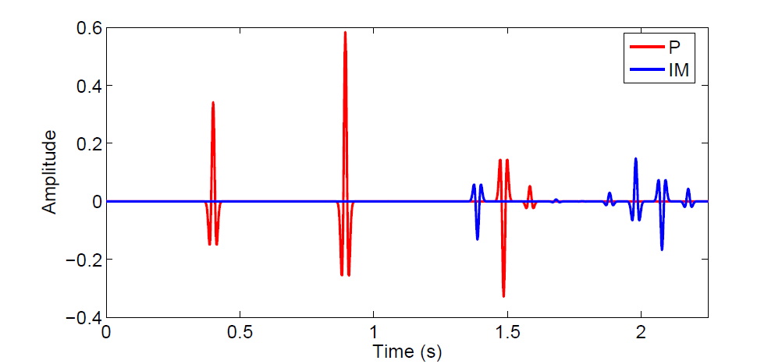
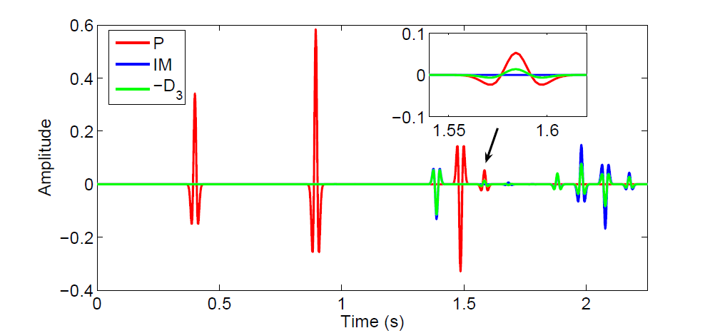
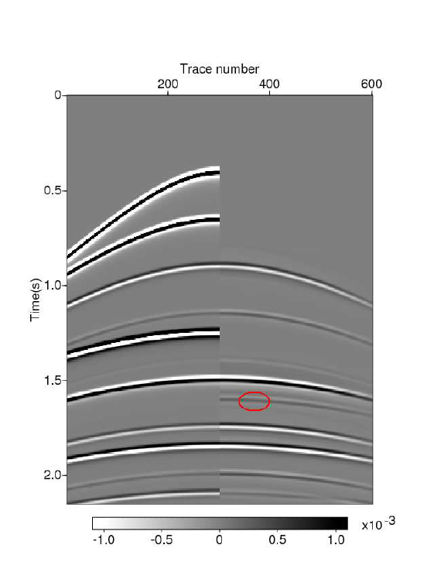
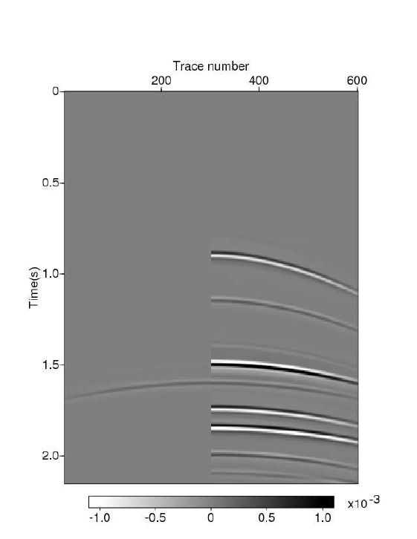
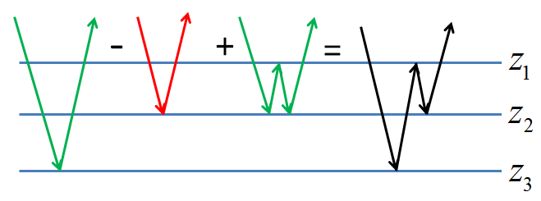
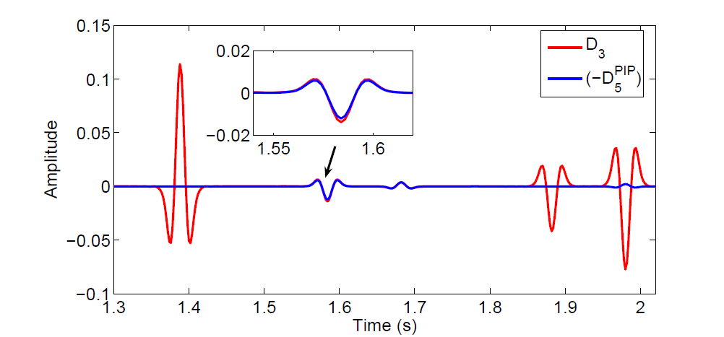
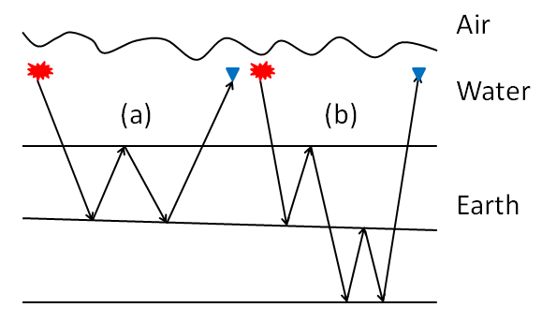
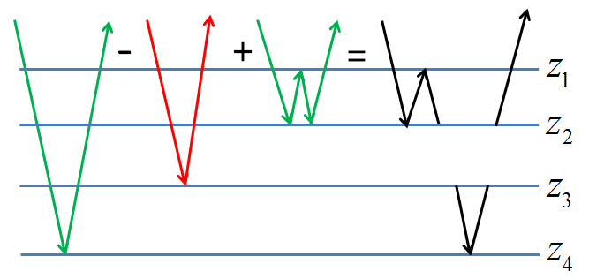
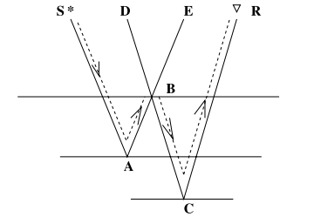
General theory for accommodating primaries and multiples
in internal multiple algorithm: analysis and numerical tests
Hong Liang*, Chao Ma and Arthur B. Weglein
M-OSRP/Physics Dept./University of Houston
Abstract
combination of “primary–internal multiple–primary”, which can occur in media with at least three reflectors. For the removal of this type of spurious events, substituting b₃ for the second b₁ in equation 1 leads to equation 3. The subevent combination of “primary–predicted internal multiple–primary” in equation 3 can be used to attenuate the spurious event. This higher-order term is identified from the ISS in Ma et al., 2012.
Figure 6a shows the input data D (generated by the reflectivity method using the model in Figure 5). Figure 6b is the comparison of D and the result of –D₃. The upper right box shows that the spurious event (green) generated by the leading-order attenuator is overlapping with the target primary (red). When using the original algorithm (D+ D₃), the spurious event will destructively interfere with the fourth primary.
The inverse scattering series (ISS) predicts internal multiples directly and without subsurface information (Weglein et. al., 2003). This is achieved through a task-speciﬁc subseries within the overall ISS. In the subseries that removes ﬁrst-order internal multiples, the second term is called the leading-order attenuator of first-order internal multiples. The basic idea behind the leading-order attenuator is that ﬁrst-order internal multiples can be predicted by the combination of primaries that satisfy the ‘lower-higher-lower’ relationship in the pseudo-depth domain. However, the entire data set, consisting of primaries and internal multiples, enters the algorithm. When internal multiples act as subevents, the leading-order attenuator produces not only ﬁrst-order internal multiples, but also higher-order internal multiples and, at times, “spurious” events (that do not correspond to any actual events in input data). This abstract shows how the ISS responds to the issue of spurious events and strengthens the internal multiple algorithm by accommodating primaries and internal multiples.
(3)
Figure 5: 1D model for data generation.
The modified ISS internal multiple algorithm for the three-reflector case is
Figure 3: Subevent construction of a spurious event when an internal multiple acts as a subevent in the second integral.
(4)
In Figure 6c, the upper box shows the actual spurious event (red) in D₃ and the predicted spurious (blue) in . From the result, we can see that, by adding
to D_{3,} the spurious event will be attenuated. Therefore, the modified algorithm can address the issue due to spurious events.
which provides the beneﬁt of the original algorithm while addressing issues due to spurious events.
The problem is yet more complicated when an internal multiple subevent is in either of the outer integrals.
(a)
Introduction
(a)
The ISS internal multiple method (Araújo et al., 1994 and Weglein et al., 1997) predicts internal multiples at all depths at once. The ﬁrst term in the algorithm is the deghosted data D from which the reference waveﬁeld and free-surface multiples have been removed and source wavelet has been deconvolved. Consider a 1D earth and a normal incidence spike wave; we first Fourier transform the input data and then perform a water speed migration by using
As shown in Figure 4a, the predicted event has the same pseudo-depth as a second-order internal multiple. This occurs in a medium with number of reflectors N≥2.
Figure 4b shows that the predicted event has the same pseudo-depth as a first-order internal multiple. This happens in a medium with N≥3.
Figure 4c shows that a spurious event is generated when 2z₂-z₁>z₃. This type of spurious event can only be generated in a medium with N≥4.
Using the same logic, we propose another higher-order term in equation 5 to address the second type of spurious event by replacing the third b₁ in equation 1 with b₃. Since this type of spurious event could be produced by the leading- order attenuator using a first-order internal multiple subevent in either of the outer integrals (these two cases are equivalent), there is a leading coefficient 2 in equation 5.
(b)
N ≥2
(b)
(c)
N ≥3
where k=2ω/c₀, and z is “pseudo depth” determined by the water speed image b₁(z).
The second term in the algorithm is the leading-order
attenuator of ﬁrst-order internal multiples (the order of internal multiples is defined by the number of downward reflections from any subsurface reflectors, as shown in Figure 1):
(c)
Figure 1: (a) a first-order internal multiple; (b) a second-order internal multiple.
(a)
(b)
Figure 6: (a) Input data D (red-primaries, blue-multiples); (b) Comparison of D and –D₃ (green); (c) Comparison of D₃ (red) and (blue).
N ≥4
Figure 7: (a) Left is the input shot gather, and right is the result of –D₃; (b) Left is the result of , and right is the result of –D_{3.}
Figure 4: Events predicted by the leading-order attenuator when an internal multiples is treated as a subevent in one of the outer integrals: (a) a second-order internal multiple; (b) a first-order internal multiple; (c) a spurious event.
The modified algorithm can be also extended to a 1D prestack example. Figure 7a shows on the left a shot gather, and on the right the predicted events in -D₃, in which the red circle marks the generated spurious event. The right panel in Figure 7b is the same as Figure 6a, while the left panel shows the spurious event predicted by .
(1)
The data with ﬁrst-order internal multiples attenuated are
(2)
where D₃(t) is the inverse Fourier transform of D₃(ω) and D₃(ω)=b₃(k) for an incident spike wave. Weglein and Matson (1998) showed that this algorithm can be interpreted using the subevent concept (Figure 2).
Figure 2: Subevents for a
first-order internal multiple. (SABCR)_{time}=(SABE)_{time}+ (DBCR)_{time} – (DBE)_{time}.
(5)
Conclusions
The modified ISS internal multiple algorithm for the case with more than three reflectors is:
This work is part of the strategy to provide further capability for internal multiple attenuation in onshore or complex offshore exploration areas. The modiﬁed algorithm presented in this paper and in Ma et al. (2012) addresses a shortcoming of the current leading-order ISS internal multiple attenuation algorithm observed in the examples of Fu et al. (2010) and Luo et al. (2011). Spurious events can be a problem if they are proximal to or interfere with primaries or multiples. The modiﬁed ISS internal multiple attenuation algorithm retains the beneﬁt of the original algorithm while addressing the issue of spurious events. It now accommodates both primaries and internal multiples in the input data.
The general output of the leading-order attenuator
(6)
In this section, we illustrate in a 1D earth the general output of the leading-order attenuator when both primaries and internal multiples are treated as subevents and propose a modified internal multiple algorithm to accommodate both primaries and multiples in the input data. Ma et al. (2012) show that, in a medium with three reﬂectors and when an internal multiple acts as a subevent in the second of the three integrals (in equation 1), a spurious event can be produced (as shown in Figure 3). The spurious event is produced by the subevent
Numerical examples
In this section, we will compute and analyze the modified ISS internal multiple attenuation algorithm for 1D models. In the following two examples, only the first type of spurious event will be generated by the leading-order attenuator, so only the high-order term in equation 3 will be examined.

